Slide 1
Mechanistic Interpretability

Slide 2
Motivation
Model explainabiltiy vs performance trade off

Slide 3
Table of Contents
AI Explainability (Diagram the context)
Mathematical Framework for Transformers
Mechanistic Interpretability Toy Example
Neural Beta
Autofromer
CKA
Concept Bottlenecks

Slide 4
XAI
1. Top level: What do we mean by “explainability”?
At the highest level, you’ve got three broad approaches to understanding models:
Black-box / behavioral explanations
  Treat the model as a function: you poke it with inputs, see outputs.
  Focus: What does it do?
  Examples: performance metrics, partial dependence plots, counterfactuals.
Feature-level explanations
  Explain predictions in terms of input features.
  Focus: Which features matter, and how?
  Examples: SHAP, LIME, saliency maps, integrated gradients, feature importance.
Mechanistic / internal explanations
  Open the box, study the internal computation.
  Focus: How is this function implemented inside the network?
  Here is where mechanistic interpretability lives.
So mechanistic interpretability is not “another XAI method”; it’s a different level of explanation (internal mechanisms vs behavior or input features).

Slide 5
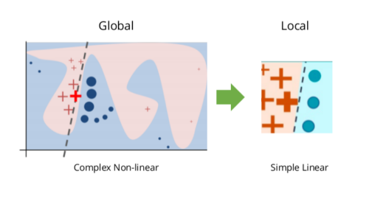
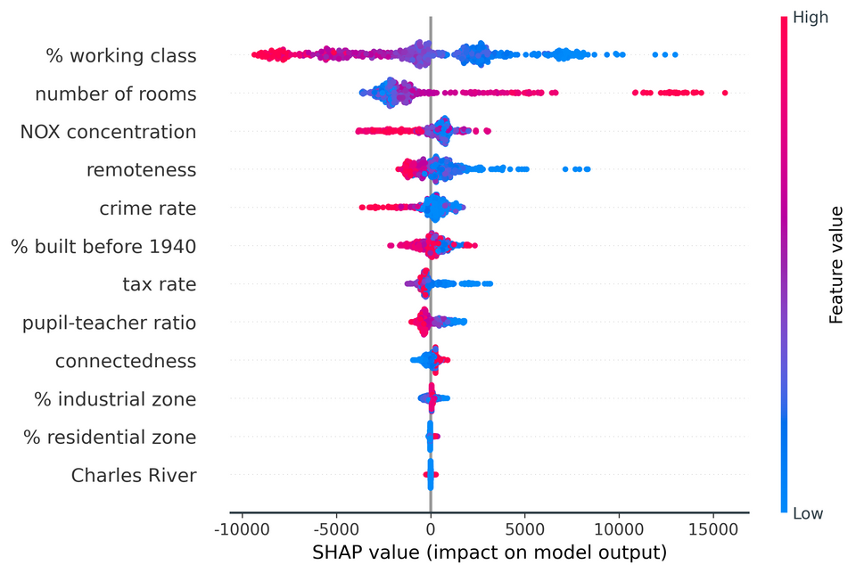
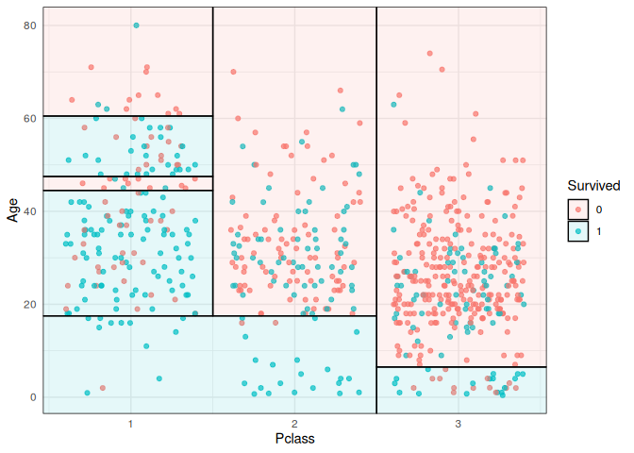
Explainable AI (XAI) 3 Axes
Intrinsic vs Post-Hoc
Local vs Global
Model Agnostic vs Specific
Intrinsic interpretability: the model is designed to be interpretable
Linear models, small trees, GAMs, monotonic networks, symbolic models.
Post-hoc interpretability: explain a trained black box
LIME, SHAP, saliency, counterfactuals, probing, etc.
Local: explain a single prediction (why did the model do X for this input?).
Global: explain the model’s overall behavior (what function does it compute?).
Model-agnostic: treat the model as a black box (LIME, SHAP, counterfactuals).
Model-specific: use the internal structure (tree path explanations, attention patterns, convolution filters).

Slide 6
Mechanictic Interpretability (Anthropic)
circuits/algorithms.
Mechanistic interpretability:
Mostly post-hoc (we take a trained net and reverse-engineer it),
But often aspires to intrinsic understanding of specific
Mechanistic interpretability is primarily:
Global (what algorithm is this attention head implementing?),
But can support local explanations (this particular token activated this particular circuit).
Strongly model-specific, and currently most developed for:
Transformer language models
Small vision models and toy models
One of the cleanest example of mechanistic interpretability (PROGRESS MEASURES FOR GROKKING VIA MECHANISTIC INTERPRETABILITY).
We’ll examine this methods for

Slide 7
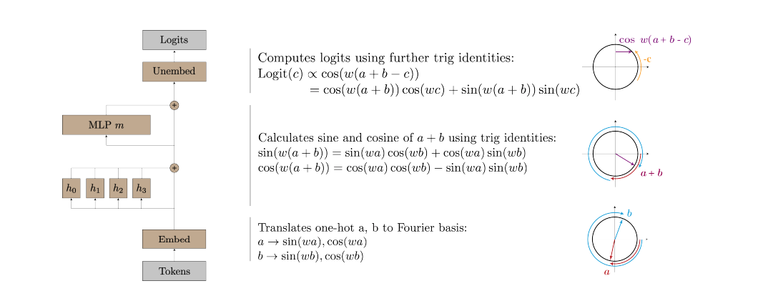
Toy Transformer Model – Mechanistic Interpretability
Setting: Deterministic dataset, single layer self-attention transformer
Goal: Modular addition where a model takes inputs a, b ∈ {0, . . . , P −1} for some prime P and predicts their sum c mod P.
Completely mapping each step of the transformer to analytical functions. How?

Slide 8
Evidence
Periodic structure in network weights and activations
Actual mechanism implemented by unembedding matrix W_L
Ablation study to confirm
Set of techniques here don’t guarentee explainability for time series transformer.
The focus is rather to question the black-boxeness of transformers.

Slide 9
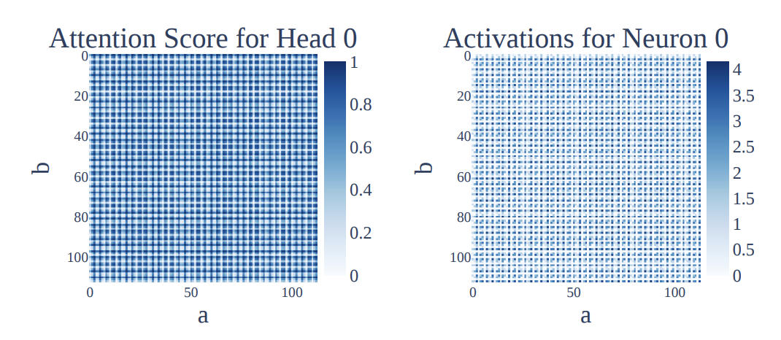
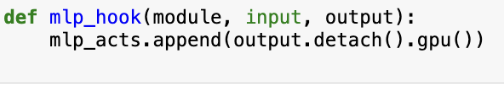
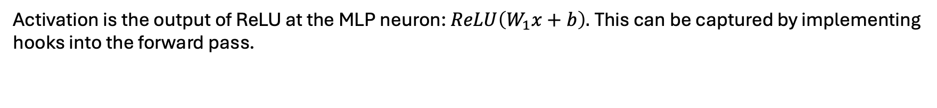
Periodic Structure and the Embedding/Unembedding matrices
The attention score for head 0 from the token ‘=’ to ‘a’, as a function of inputs a, b.
The activations of MLP neuron 0 given inputs a, b. Both the attention scores and the neuron activations are periodic.
Frequency domain.
Activation is the output of ReLU at the MLP neuron: $ReLU\left(W_{1}x+b\right).$This can be captured by implementing hooks into the forward pass.
Detach removes it from the computation graph (backpropagation)

Slide 10
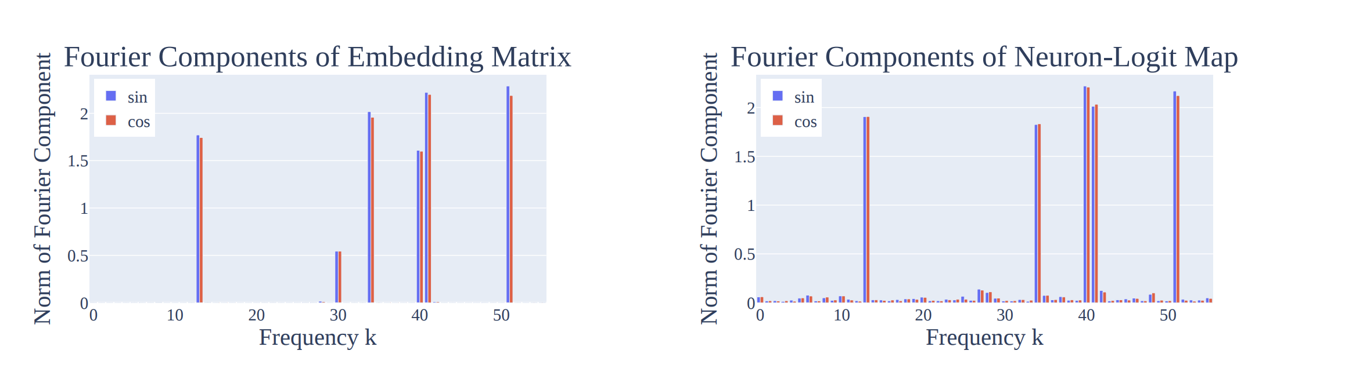
Embedding and Unembedding Matrices
The norms of the Fourier components in the embedding matrix WE. As discussed in Section 4.1, the sparsity of WE in the Fourier basis is evidence that the network is operating in this basis. Of the six non-zero frequencies, five “key frequencies” appear in later parts of the network, corresponding to k ∈ {14, 35, 41, 42, 52}. (Right) Norm of Fourier components of the neuron-logit map WL. A Fourier transform is taken over the logit axis, and then the norm is taken over the neuron axis. As discussed in Section 4.2, WL is well-approximated by the 5 key frequencies wk.

Slide 11
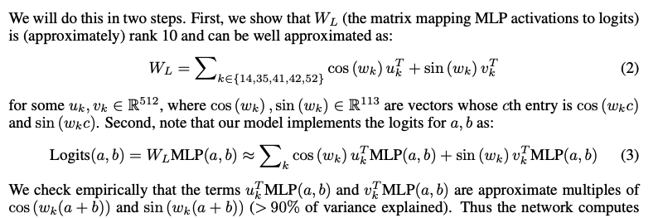
Mechanistic Evidence
Claim:The functions cos (wk(a + b)), sin (wk(a + b)) are linearly represented in the MLP activations, and the unembed matrix reads these linear directions and multiplies them by cos (wkc), sin (wkc) respectively

Slide 12
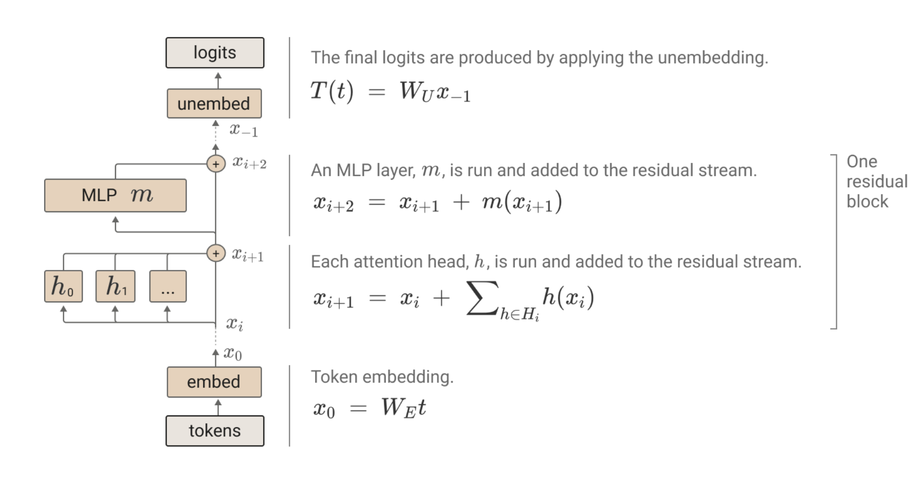
A Mathematical Framework for Transformers
The residual stream is simply the sum of the output of all the previous layers and the original embedding. We generally think of the residual stream as a communication channel, since it doesn't do any processing itself and all layers communicate through it.
This ignores the layer normalization at the start of each layer, but up to a constant scalar, the layer normalization is a constant affine transformation and can be folded into the linear transformation. See discussion of how we handle layer normalization in the appendix.

Slide 13
Table of Contents
AI Explainability – Mechanistic Interpretability
A simple transformer example to show what is the possibility
Financial time series

Slide 14
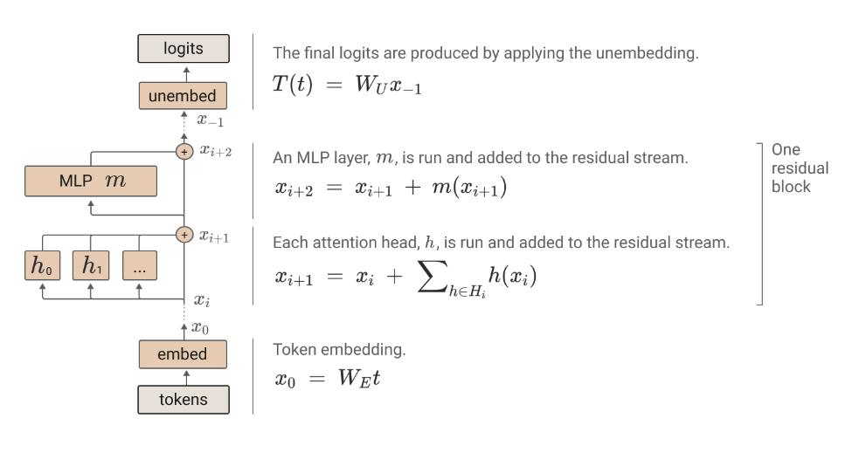
Both the attention and MLP layers each “read” their input from the residual stream (by performing a linear projection), and then “write” their result to the residual stream by adding a linear projection back in. Each attention layer consists of multiple heads, which operate in parallel.
One of the main features of the high level architecture of a transformer is that each layer adds its results into what we call the “residual stream.” ² The residual stream is simply the sum of the output of all the previous layers and the original embedding. We generally think of the residual stream as a communication channel, since it doesn't do any processing itself and all layers communicate through it.

Slide 15
The residual stream has a deeply linear structure. ³ Every layer performs an arbitrary linear transformation to "read in" information from the residual stream at the start, ⁴ and performs another arbitrary linear transformation before adding to "write" its output back into the residual stream. This linear, additive structure of the residual stream has a lot of important implications. One basic consequence is that the residual stream doesn't have a "privileged basis"; we could rotate it by rotating all the matrices interacting with it, without changing model behavior.
Privileged Basis vs Basis Free: A privileged basis occurs when some aspect of a model’s architecture encourages neural network features to align with basis dimensions, for example because of a sparse activation function such as ReLU. In a transformer, the only vectors with privileged bases are tokens, attention patterns and MLP activations. See the appendix table of variables for a full list of which activations have or don’t have privileged activations.
Some types of interpretability only make sense for activations with a privileged basis. For example, it doesn't really make sense to look at the "neurons" (ie. basis dimensions) of activations like the residual stream, keys, queries or values, which don't have a privileged basis. This isn't to say that there aren't ways to study them; a lot of interesting work is done on word embeddings without assuming a privileged basis (e.g.
[11]
). But having a privileged basis does open up helpful approaches.

Slide 16
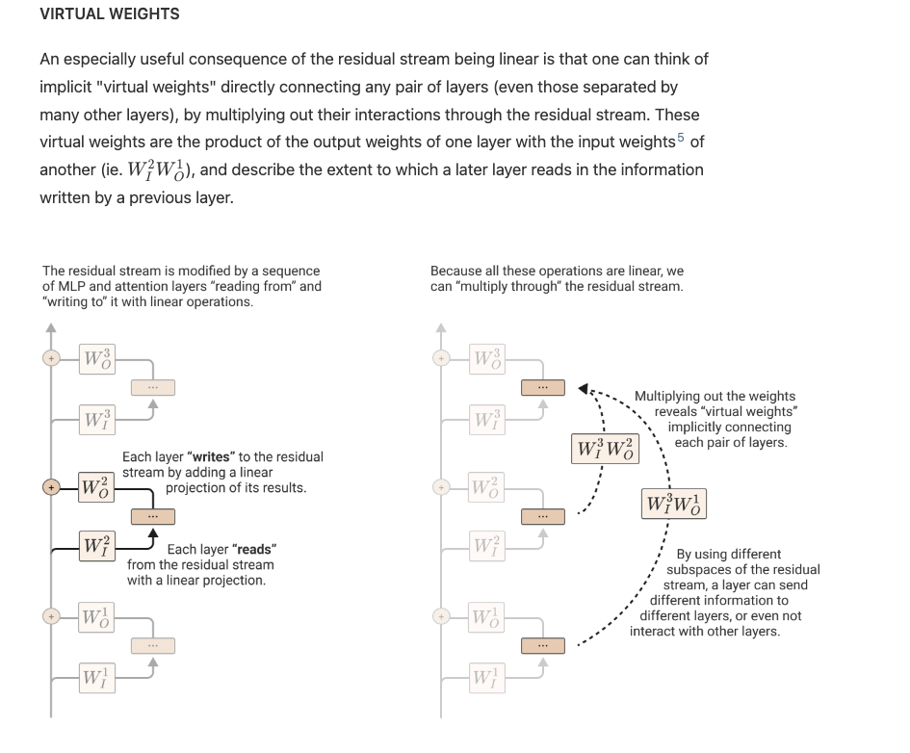
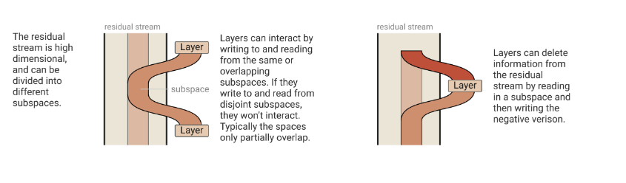

Slide 17
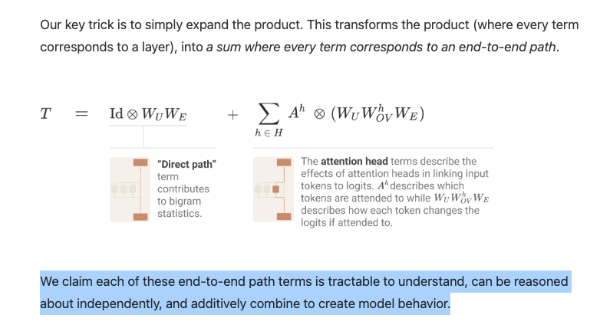
Attention Heads are Independent and Additive
Attention Heads as Information Movements

